Slide 1
Title Goes Here and Here and Here
Speaker’s Name, SAP
Month 00, 2019
Partner logo

Slide 2
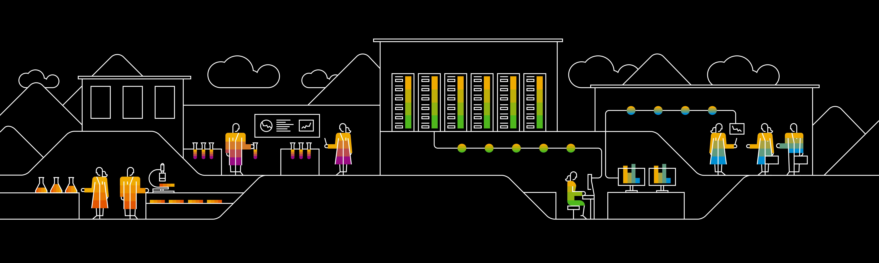
Title Goes Here and Here and Here
Speaker’s Name, SAP
Month 00, 2019
Partner logo

Slide 3
Agenda
What is Machine Learning?
Details
Comparison Between: Data Science, AI, ML, and Deep Learning
Artificial Intelligence
Machine Learning
Deep Learning
Data Science
Agenda item/divider headline
Details
Agenda item/divider headline
Details

Slide 4

What is Machine Learning?

Slide 5
Overview
Artific
Artificial Intelligence
Machine Learning
Data Science
Deep Learning
Image 1

Slide 6
Artificial Intelligence
Artificial intelligence is the simulation of human intelligence processes by machines, especially computer systems. These processes include learning (the acquisition of information and rules for using the information), reasoning (using rules to reach approximate or definite conclusions) and self-correction
Some examples of AI:
IBM Watson
Microsoft Cognitive Services
Google AI
Amazon AI

Slide 7
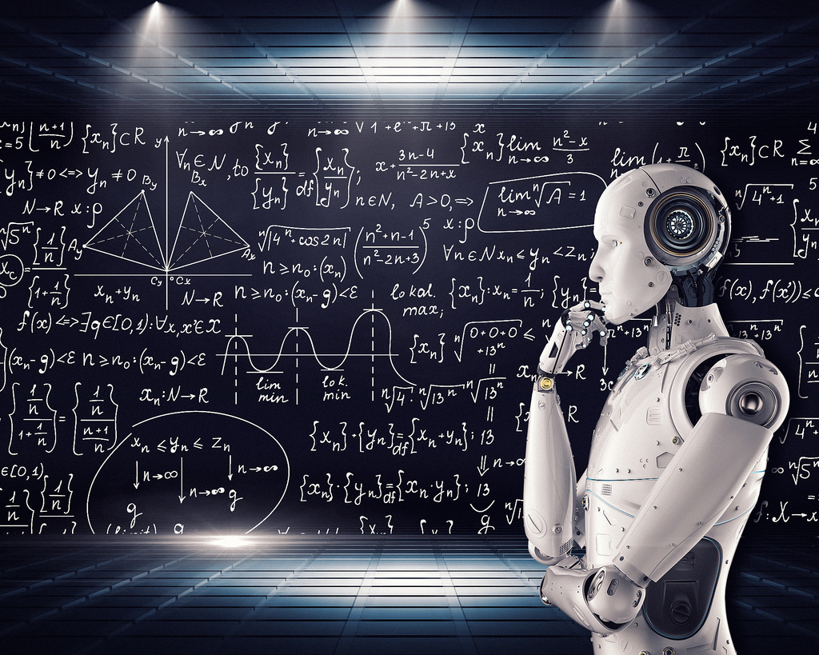
Machine Learning Subheadline
Machine learning is an application of artificial intelligence (AI) that provides systems the ability to automatically learn and improve from experience without being explicitly programmed. Machine learning focuses on the development of computer programs that can access data and use it learn for themselves.
Types of Machine Learning:
Supervised Machine Learning
Unsupervised Machine Learning
Reinforcement Machine Learning
Image 2

Slide 8
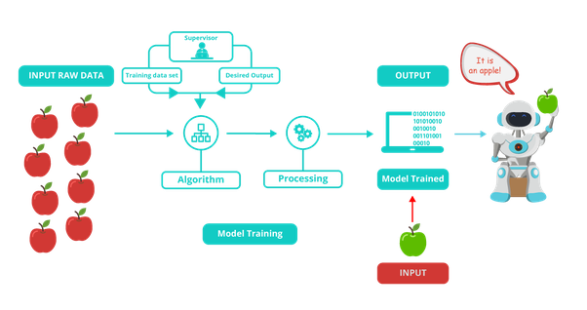
Supervised Learning
Image 3

Slide 9
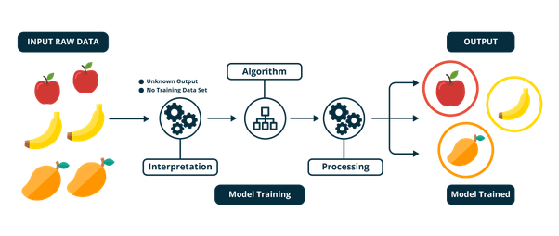
Unsupervised Learning
Image 4

Slide 10
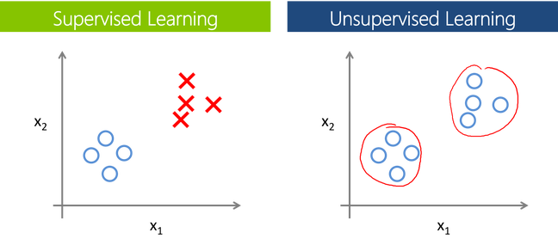
Supervised vs Unsupervised
Image 5

Slide 11
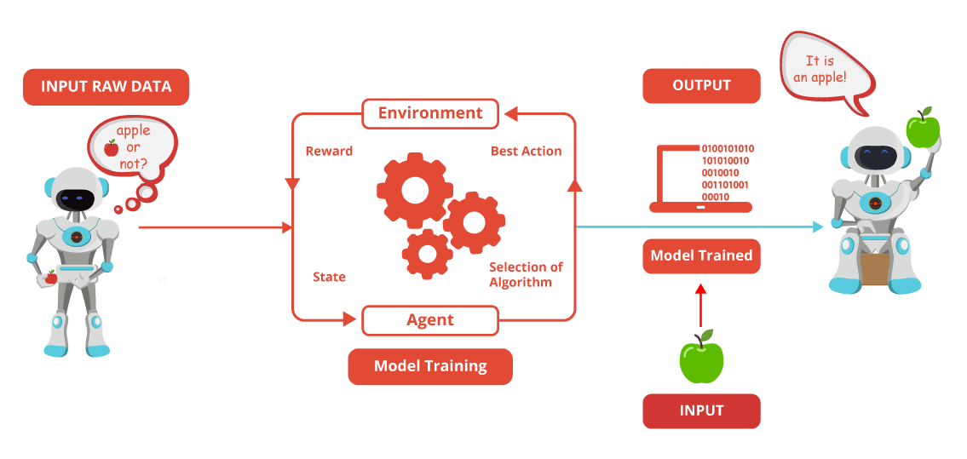
Reinforcement Learning
Image 6

Slide 12
Deep Learning
Deep Learning is a subfield of machine learning concerned with algorithms inspired by the structure and function of the brain called artificial neural networks.
Both machine and deep learning are subsets of artificial intelligence, but deep learning represents the next evolution of machine learning. In machine learning, algorithms created by human programmers are responsible for parsing and learning from the data. They make decisions based on what they learn from the data. Deep learning learns through an artificial neural network that acts very much like a human brain and allows the machine to analyze data in a structure very much as humans do.
Examples:
Customer Experience, Translations, Computer Vision, Image caption generation,

Slide 13
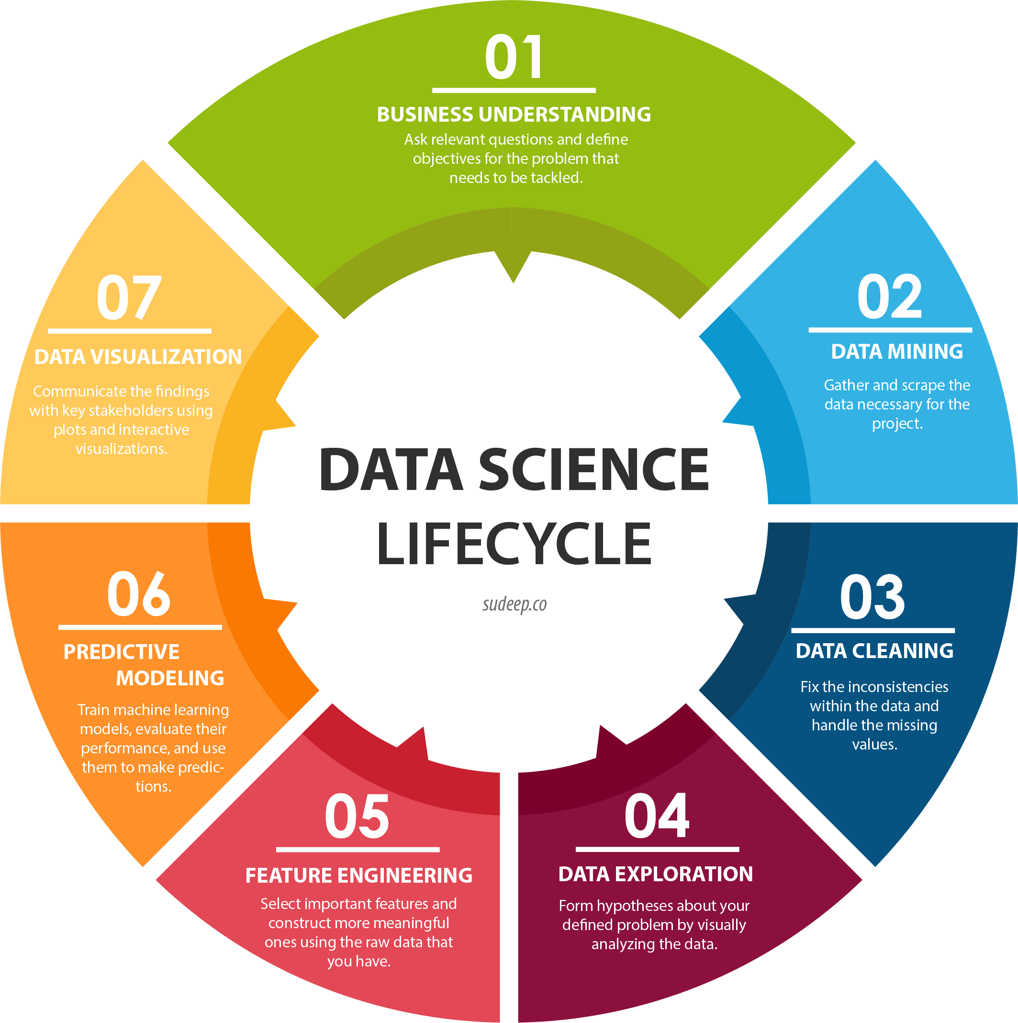
Data Science
The art of uncovering the insights and trends in data has been around since ancient times.
The ancient Egyptians used census data to increase efficiency in tax collection and they accurately predicted the flooding of the Nile river every year.
Data Science is a blend of various tools, algorithms, and machine learning principles with the goal to discover hidden patterns from the raw data.
Image 7

Slide 14
Thank you.
Contact information:
F name L name
Title
Address
Phone number
Partner logo

Slide 15
References
Image 2
Image 3
Image 4
Image 5
Image 6
Image 7

